Slide 1


Smartcare Healthcare Consultancy
Where our journey begins!!

Slide 2
Contents of this template
Here’s what you’ll find in this Slidesgo template:
A slide structure based on a healthcare center presentation, which you can easily adapt to your needs. For more info on how to edit the template, please visit Slidesgo School or read our FAQs.
An assortment of graphic resources that are suitable for use in the presentation can be found in the alternative resources slide.
A thanks slide, which you must keep so that proper credits for our design are given.
A resources slide, where you’ll find links to all the elements used in the template.
Instructions for use.
Final slides with:
The fonts and colors used in the template.
A selection of illustrations. You can also customize and animate them as you wish with the online editor. Visit Storyset to find more.
More infographic resources, whose size and color can be edited.
Sets of customizable icons of the following themes: general, business, avatar, creative process, education, help & support, medical, nature, performing arts, SEO & marketing, and teamwork.
You can delete this slide when you’re done editing the presentation.

Slide 3
Table of contents
01
Our Center
02
Consultancy
03
Patient Care
04
Results
Our main Aim is to give you the best experience.
We ensure our patients are given the best solutions.
Our patients are handled by best practioner
Are out after two business days.

Slide 4
Whoa!
Hey there am Ivy and let me take you through my Agency, you can contact me at maleeivy@gmail…

Slide 5

01
SmartCare Healthcentre
Some INTRO to what we do;

Slide 6

Introduction
At our Health Consultancy Agency, we are dedicated to empowering individuals and organizations to make informed, proactive, and positive choices when it comes to health and wellness. With a team of experienced and highly qualified health consultants, we provide a wide range of services aimed at improving overall health and well-being.

Slide 7

Our center
With a team of experienced and highly qualified health consultants, we provide a wide range of services aimed at improving overall health and well-being.

Slide 8
Values of the company
Mission
Vision
To create a better everyday life for the many people
Bring inspiration and innovation to every athlete in the world.

Slide 9

So , why choose us...
Our team of certified health consultants brings a wealth of knowledge and experience in various health disciplines.

Slide 10
Half way there!

Slide 11

—Hippocrates.
"Wherever the art of Medicine is loved, there is also a love of Humanity. ”

Slide 12

~Expertise ~Personalized Approach ~Client-Centered ~Holistic Wellness

Slide 13

Numbers don't lie..
20,000
50,000
This is the number of patients we had last month
This is the number of total visitors we had last month
5,000
This is the number
of transplants performed

Slide 14

Our statistics
March
Most patients had chronic illnesses
October
We received the most cases of flu

Slide 15

A brief story
Contact lenses provide vision correction, along with a built-in photochromic filter that responds to changing light conditions—leading to its recognition by Time as a Best Invention of the year.
Helps provide treatments to millions of kids across the globe to address everything from tuberculosis to intestinal worm infections
Half of all medicines used to treat children today do not have any information on their labels about proper use for kids

Slide 16
Milestones reached
2020-2021
Hospital of the year award
Year
2022
2018-2019
It’s giant and the biggest
2019-2020
2017-2018
Recognised by WHO

Slide 17
Our process
01
Venus
Mars
03
Venus has a beautiful name
Despite being red, Mars is cold
02
Saturn
Jupiter
04
It’s a gas giant and has rings
Jupiter is the biggest planet

Slide 18

02
Consultants
Holistic Wellness

Slide 19

Patient care
We prioritize open communication and collaboration, ensuring that our clients actively participate in their health improvement plans.

Slide 20
Services
Health Assessments
Lifestyle Coaching
Guidance
Wellness Programs
Pg.22
Pg.24
Pg.23
Pg.25

Slide 21
Key accomplishments
May
July
September
Despite being the most difficuit month ,we had the most successful surgeries
It’s a month of hostility and resiliance
Yes, this is the ringed one.

Slide 22
This is a map
Locations
We are located in the following Countries
America
It’s our biggest location yet
Kenya
Our numbers increase on the daily

Slide 23
4,498,300
Big numbers catch your audience’s attention

Slide 24
333,000,000
9h 55m 23s
386,000 km
Hours we've served
Time a day
Distances we've covered for our clients

Slide 25
Patient satisfaction
60%
80%
30%
May
June
December
May was tough but great
The best month for us so far
Despite being red, it was most calm

Slide 26
This is a table
 | Qty. | Booked | Sold | Refund | Percent
May | 2 | 12000 | 9800 | 500 | 80%
June | 3 | 6000 | 5000 | 450 | 50%
July | 4 | 2000 | 1500 | 300 | 70%
September | 9 | 6000 | 5000 | 450 | 50%
May was truly the busiest we've been this year

Slide 27
Innovations
React
Vue
Vite

Slide 28
Awards
MAY
JULY
OCTOBER
DECEMBER
2017-2018
2018-2019
2019-2020
2020-2021

Slide 29

Our team
Ms. Gina
Mr. Rena
DIRECTOR SMARTCARE AND WELLNESS
C.O.O AND C.E.O

Slide 30
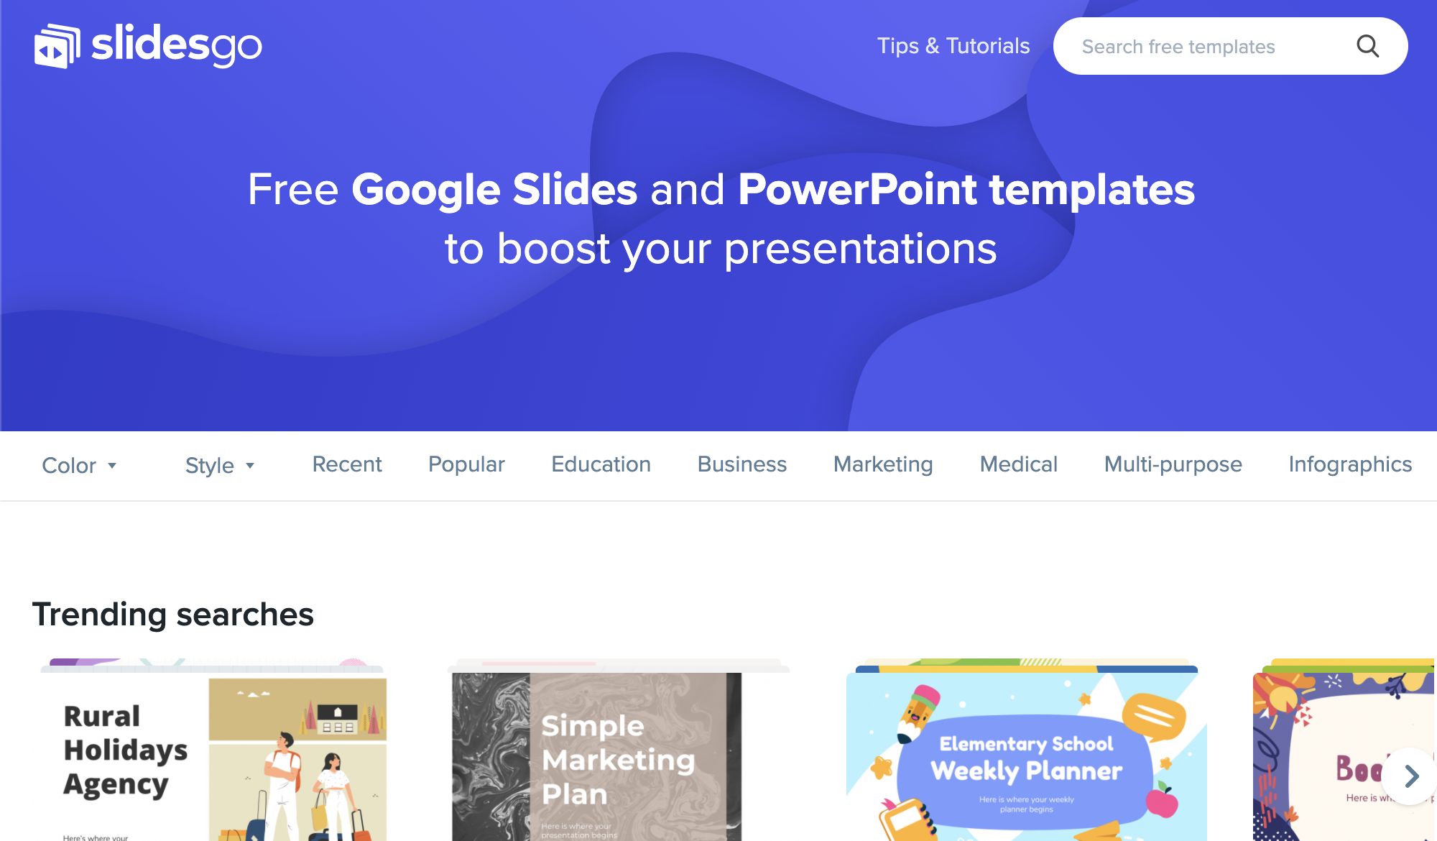
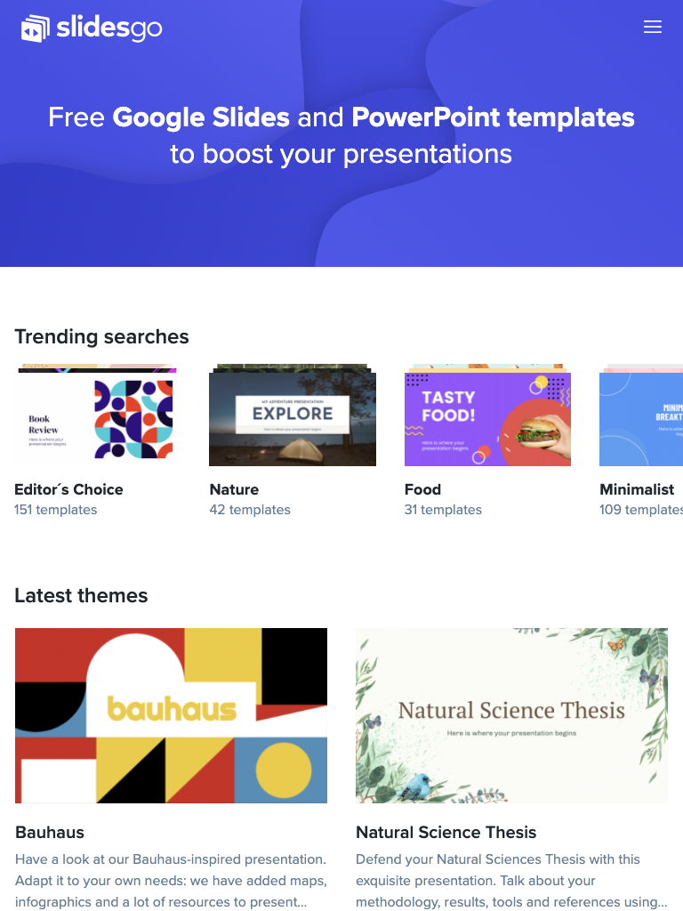
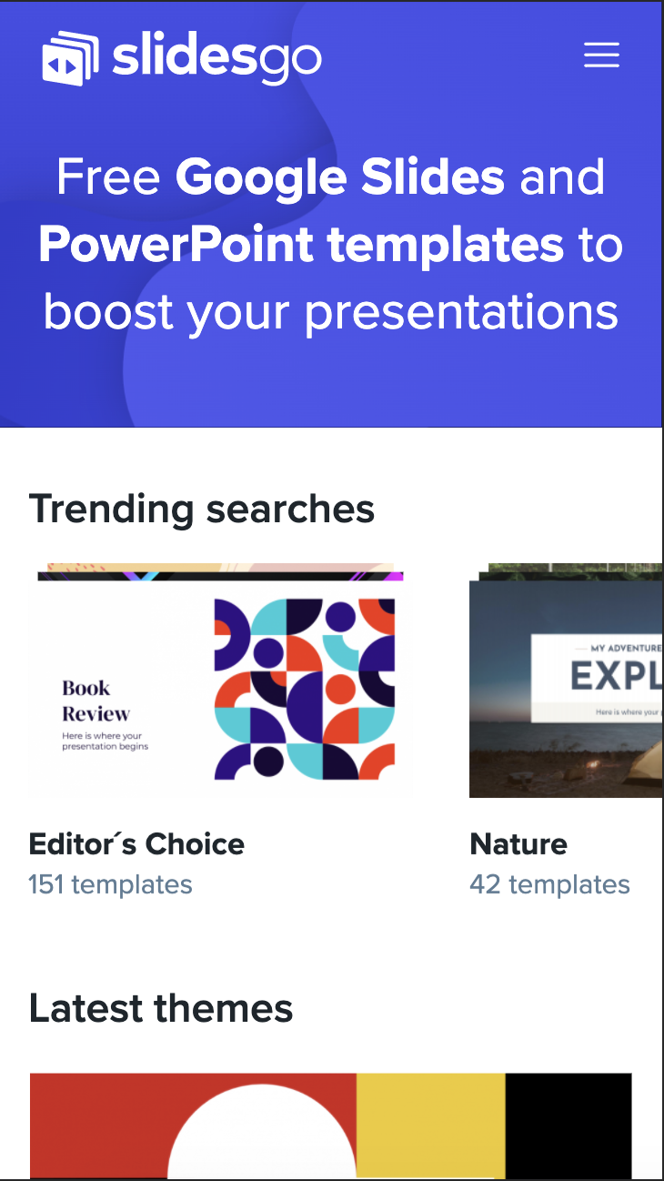
Challenges
Some of the challenges were to display the images
Also the use of good API'S in my code

Slide 31
Thanks
Do you have any questions?
addyouremail@freepik.com | +91 620 421 838 | yourcompany.com
Please keep this slide for attribution

Slide 32

Alternative resources
Here’s an assortment of alternatives resources within the same style of this template. Find more illustrations like these on Storyset

Slide 33
Resources
Did you like the resources on this template?
Get them for free at our other websites:
Freepik
Medium shot old woman caregiver talking
Old man sitting wheelchair while talking nurse
Medical team posing with laptop screen
Long shot old man sitting wheelchair
Storyset
Doctor
Medicine
World health day
Health professional team
Blood donation
Ffp2 face mask
Vaccine phases
Find more illustrations like these on Storyset

Slide 34
Fonts & colors used
This presentation has been made using the following fonts:
Prata
(https://fonts.google.com/specimen/Prata)
Exo
(https://fonts.google.com/specimen/Exo)
#252e47
#ffffff
#f8f5ec
#ece9e1
#dadace

Slide 35





Storyset
Create your Story with our illustrated concepts. Choose the style you like the most, edit its colors, pick the background and layers you want to show and bring them to life with the animator panel! It will boost your presentation. Check out How it Works.
Pana
Amico
Bro
Rafiki
Cuate

Slide 36


